Slide 1
How to ORM

Slide 2
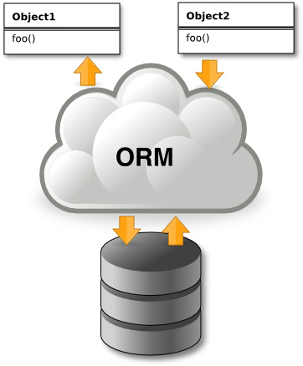
WTF is ORM?
ORM (Object-relational mapping) is a programming technique for converting data between relational and object-oriented data models.
This creates a "virtual object database" that can be used from within the programming language.

Slide 3
Existing ORM approaches
Data Access Object design pattern
JPA/Hibernate
Active Record
Generic DAO

Slide 4
CRUD interface…
…allows us to:
CREATE - Create or add new records.
RETRIEVE - Read, retrieve, search, or view existing records.
UPDATE - Update or edit existing records.
DELETE - Delete/deactivate existing records.

Slide 5
Generic programming <T>
Allows a type or method to operate on objects of various types while providing compile-time type safety.
Generic methods defines operations on data types which are not exactly known at compile time.

Slide 6
Java Reflection API
Reflection is the ability of a computer program to examine and modify its own structure and behavior at runtime.
Reflection drawbacks:
Performance Drops
Security Restrictions
Reflection is powerful, but should not be used indiscriminately. If it is possible to perform an operation without using reflection, then it is preferable to avoid using it.

Slide 7
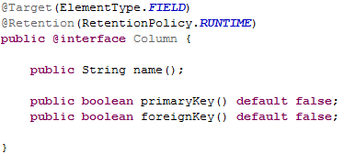
Annotations
Annotations is a form of metadata, provide data about a program that is not part of the program itself. Annotations have no direct effect on the operation of the code they annotate.
Information for the compiler — Annotations can be used by the compiler to detect errors or suppress warnings.
Compile-time and deployment-time processing — Software tools can process annotation information to generate code, XML files, and so forth.
Runtime processing — Some annotations are available to be examined at runtime.

Slide 8
Resources
Example source code: https://github.com/loganstk/DBO
Annotations tutorial: https://docs.oracle.com/javase/tutorial/java/annotations/,
http://www.quizful.net/post/annotations-in-java
Reflection tutorial: http://www.quizful.net/post/java-reflection-api,
http://www.javenue.info/post/84
Generics tutorial: http://www.quizful.net/post/java-generics-tutorial
Bruce Eckel – Thinking in Java 4th Edition

